Slide 1
Protecting Systems with Circuit Breakers

Slide 2

Overview
The role of circuit breakers in microservices
Problems with the status quo Describing Spring Cloud Circuit Breaker Creating a circuit breaker
Assessing metrics Summary

Slide 3
Capabilities That We Will Add in This Module
Toll Station UI
 | Service |  | Load Balancer |  | Circuit Breaker
 | Discovery
Toll Data Repository
API Gateway
Messaging
Fast Pass Service
Remote Toll Data Pipeline
Toll Rate Lookup Service
Toll Intake Service

Slide 4


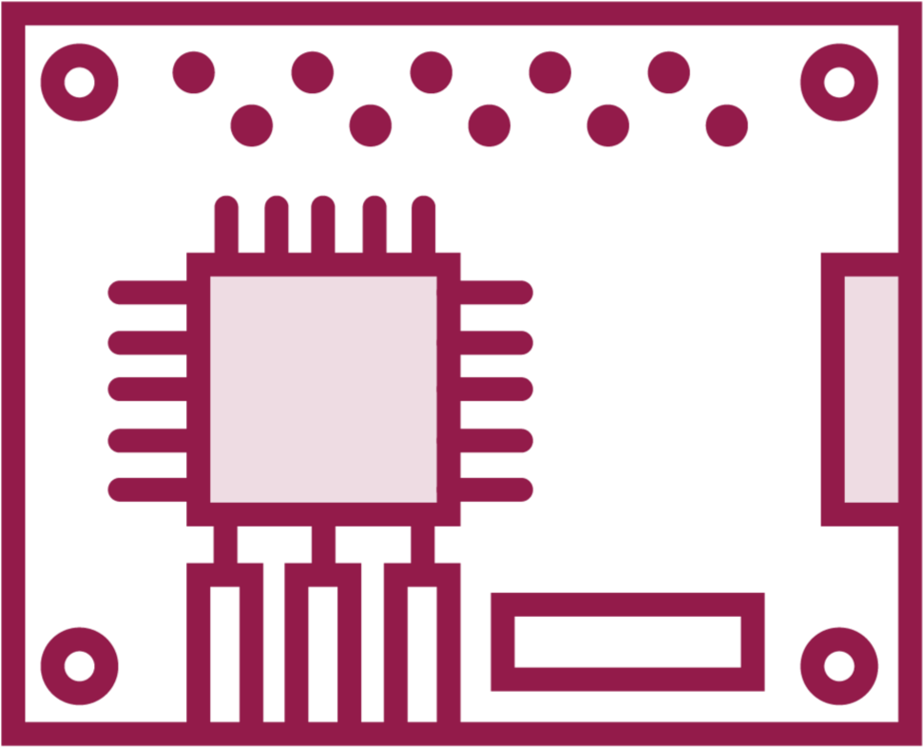
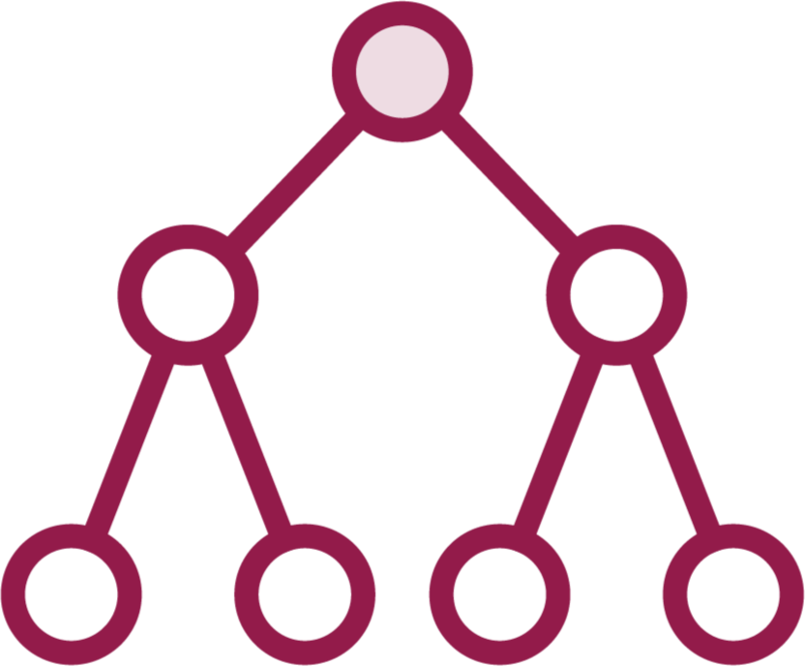
The Role of Circuit Breakers in Microservices
Circuit breakers protect an electrical circuit from damage
Watch for service faults in real-time
Circuit closes when successful request processed
Prevents cascading failures

Slide 5

Problems with the Status Quo
Major dependence on server to be resilient
Load balancers are network call too
Hard to detect and recover via automation
Solutions can be intrusive to code base or add significant overhead
Resilience engineering often not part of service logic or behavior

Slide 6
Spring Cloud Circuit Breaker
Library for enabling resilience in microservices.

Slide 7
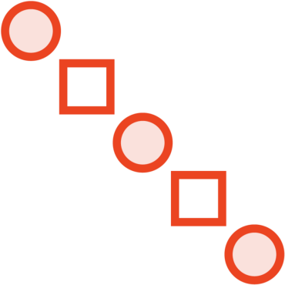


What Spring Cloud Circuit Breaker Does
Supported patterns include bulkhead, fail fast, graceful degradation (e.g. fail silently with fallback response).
Spring Cloud Circuit Breaker is an abstraction atop popular resilience libraries. Protects calls to external dependencies in reactive and non-reactive scenarios.
Can provide different circuit breakers per service, with different configurations and even different underlying libraries.

Slide 8
Comparing Supported Implementations
Resilience4j
Lightweight library that supports circuit breaker, rate limiter, bulkhead, retry, and more.
Netflix Hystrix
Maintenance-mode project that protects systems and enables resilience by implementing common patterns.
Spring Retry
Simple library that supports multiple request attempts, backoff, and recovery operations.
Sentinel
Polyglot project from Alibaba that supports many data sources and engines.

Slide 9

Creating a Circuit Breaker with Resilience4j
Choose your starter based on reactive or non- reactive applications
Create a CircuitBreakerFactory
Create a named CircuitBreaker and “run” it
Override autoconfiguration using code or properties

Slide 10

Demo
Review existing Eureka-enabled “toll rate”
microservice
Open existing client application
Add Spring Cloud Circuit Breaker dependency to project
Introduce Circuit Breaker to code Start up and call client application Review circuit and metrics endpoints

Slide 11
Looking at Advanced Configurations
Can create Customizer bean change default behavior
Customizer bean uses objects specific to each supported library
Resilience4j supports deep config for each pattern
Add configuration to code or properties file

Slide 12
Demo
Add timelimiter configuration to allow up to four seconds before timing out
Introduce circuit breaker configuration with sliding windows, slow call rate threshold, and more
Test different configurations and observe behavior

Slide 13

Accessing Circuit Breaker Metrics
Resilience4j supports auto-configuration of
metrics collection
Natively works with Micrometer for
instrumentation
Publishing to Prometheus possible, with additional classpath dependencies
Available Grafana dashboard makes visualization of circuits, and calls, possible

Slide 14
Demo
Update existing applications with classpath dependencies to resilience4j-micrometer and micrometer-registry-Prometheus
Stand up Prometheus and Grafana in Docker containers
Connect Grafana to application metrics and view open/closed circuits

Slide 15
Summary
The role of circuit breakers in microservices
Problems with the status quo Describing Spring Cloud Circuit Breaker Creating a circuit breaker
Assessing metrics

